Slide 1
More if statements
5.4-5.8

Slide 2
Nested if statements
You can put if statements inside of one another. This concept is called nesting.
If ()
{ if (0
Else
}
Else
{
If ()
}

Slide 3
Example
Given variables char gender; and boolean athlete;
Write a series of if statements that will outputs where a student athlete should sit at the athletics banquet if female athletes are sitting on the left and male athletes are sitting on the right of the hall. Non-athletes are not attending.
If (athlete)
{
If (gender == ‘m’)
Sit on right
Else
Sit on left
}
Else
Non athletes not welcome

Slide 4
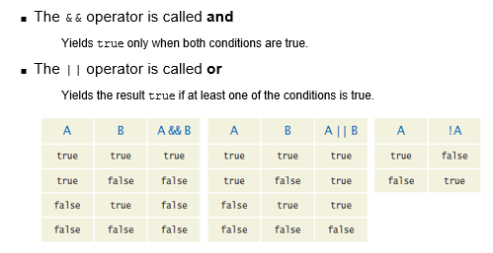
Boolean operators
Usually one question of this on AP exam
! Means “not”, not “not equals”

Slide 5
Demorgan’s law
Distributing and simplifying logical (Boolean) operators
!(A && B) = !A || !B
!(A || B) = !A && !B
You will see one question of this on AP Exam
Can distribute !, but the & switches to | (or)
Not A & B is the same as either not A nor B
Not A or B is the same as not A and not B

Slide 6
Simplify each
!(A || !B)
!A & B
!(!A && !B)
A || B
!((A || !B) || (A && B))
(!A && B) && (!A || !B)
(!A && B)
All these expressions will either evaluate to true or false because they are equivalent (the ones in each question)

Slide 7
Checking Data
Use inputs to check data. For instance, the Scanner class has a Boolean method called hasNextInt(). It returns true if there is an integer in the stream and false otherwise. so…
Allows you to do thing on next page…

Slide 8
Scanner in = new Scanner(System.in);
System.out.print(“Please enter your phone number: “);
if (in.hasNextInt())
{
int number = in.nextInt();--theres an error because this needs to be outside of if statement; it will disappear after this if statement because it only exists in there
}
else
{
System.out.println(“Error: Not a valid number”);
}

